Slide 1



2016 International Charter on Geography Education
Interactive session
(How) can EUGEO members use the
Action Plan?
Henk Ottens and Massimiliano Tabusi
Presentation EUGEO Seminar 2016 Zadar

Slide 2
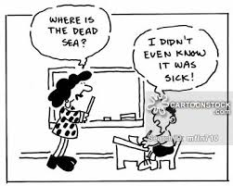
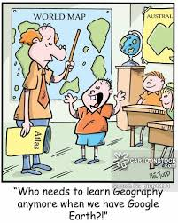
geography = topography+maps
Presentation EUGEO Seminar 2016 Zadar

Slide 3
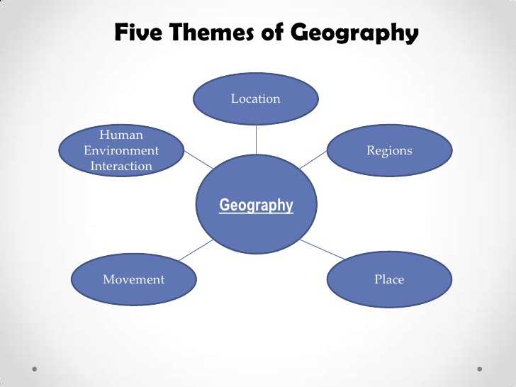
AAG 1984: geospatial approaches, maps
Presentation EUGEO Seminar 2016 Zadar
Presentation EUGEO Seminar 2016 Zadar

Slide 4

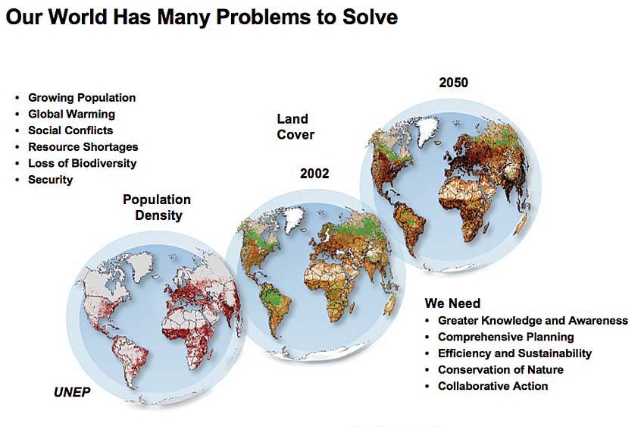

problems/issues approaches
multilevel
man-environment
multi-methods
geospatial ict
Presentation EUGEO Seminar 2016 Zadar

Slide 5
Charter on Geography Education
2010-13
EUGEO support for position school geography in countries
2013
Joint IGU/EUGEO/EUROGEO session on Geographical Education at the EUGEO Congress in Rome, leading to the Rome Declaration on Geographical Education in Europe
2014
  IGU Commission on Geography Education taking the lead resulting in draft for revision of the 1992 Charter on Geography Education
  2015
Discussion EUGEO Seminar IGU Regional Conference Kraków
2016
  Acceptance of the International Charter at IGU Beijing Conference
Presentation EUGEO Seminar 2016 Zadar

Slide 6
Website:
www.igu-cge.org

Slide 7
Affirmations
Addressing policy makers, education leaders, curriculum planners and geography educators
What is geography?
  Study of the Earth and its natural and human environments
  Study of human activities, interrelationships, interactions with environments
  From local to global scales
  Only discipline that that deals with spatial variability
  Geography education neglected in some parts of the world, lacks structure and support in others.
Contribution of geography to education
  Geography is fascinating when taught effectively. Teaching quality essential
  Geography is vital subject and resource for 21st century
  Geography helps understanding contemporary challenges and provides skills to investigate
Research in Geography Education
  Good geography teaching requires significant on-going research, time/ investments are required
  Up-to-date priority of research questions is needed
  Describing the minimum requirements for geography teaching in primary and secondary schools
International cooperation
  Sharing limited resources, assisting educators.
  Developing exchange programmes.
Presentation EUGEO Seminar2016 Zadar

Slide 8
International Action Plan
Addressing national, regional an local policy makers and the geographical education communities
Make the focus and contribution of geography education more explicit to encourage higher levels of public support.
Set official minimum requirements for geography teaching
Develop processes to encourage (inter)national exchanges of meaningful geography teasing and learning practices
Develop a relevant research agenda for geographical education and facilitate the research
Create and maintain a strong professional network structure
Presentation EUGEO Seminar 2016 Zadar

Slide 9
Questions for Group Discussion
Can an international strategy for geography education (ISGE) be useful for national/regional geographical societies/associations?
Should geographical societies/associations elaborate the ISGE into national/regional strategies/standards? Do we need a European Strategy for Geography Education (ESGE) as well?
What would be the added value of an ISGE and/or ESGE for developing national/regional curricula development and teacher education/training standards and practices?
How can EUGEO, on behalf of its member societies, best facilitate the way towards an European strategy/standard/network?
Presentation EUGEO Seminar 2016 Zadar

Slide 10
Some first ideas…
Each EUGEO member may promote the translation of the Charter in its national language, publishing it in one of the national scientific geographical journal and, in cooperation with IGU-CGE, EUGEO website may collect all the translations
EUGEO members may be encouraged to encouraged to submit, in the same day or period, the translation of the Charter to their government authorities that deal with education; simultaneously, EUGEO will send it to EU Commissioner for Education and Culture, inviting him at the Brussels Congress
During every EUGEO Congress EUGEO may promote an “award” for the geographical study that has had, has or can have, the greatest impact on society. This way, a good number of studies with concrete effects on society may emerge; the first will be rewarded, but EUGEO will help to make others known by the media
    Charter states: “The visibility of the discipline and appreciation of the significance of geography in education requires a higher media profile. Professional networks locally, regionally, nationally and internationally should be encouraged to engage the public in their work.”

